Slide 1
Non Fryer
Innovation Engagement
Discovery Share Out
12/13/18
if you're hungry, trust your APPetite.

Slide 3
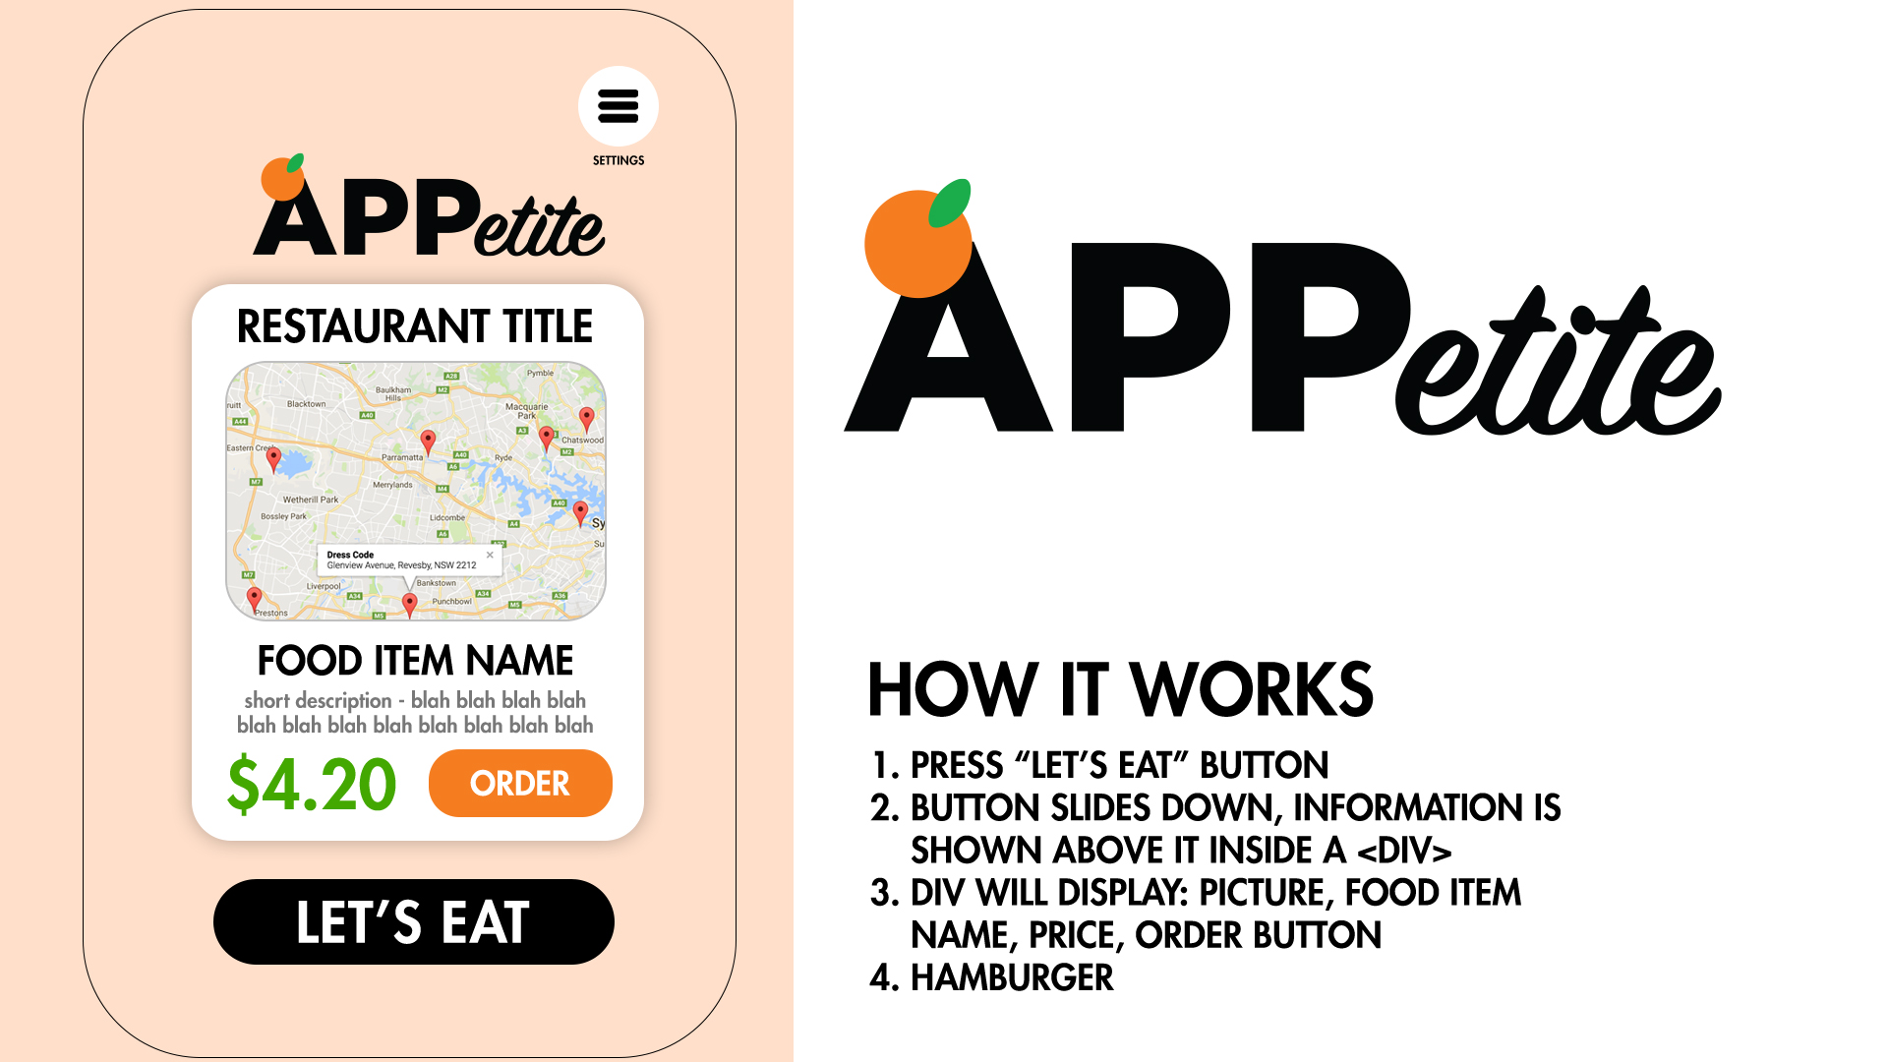

Slide 5
Server-Side APIs

Slide 6
Git branching workflow

Slide 7

Agile software development

Slide 8
What is an MVP?

